Slide 1
4-BIT UP/DOWN COUNTER BCD SYNCHRONOUS COUNTER
LECTURE 10
Part 2

Slide 2
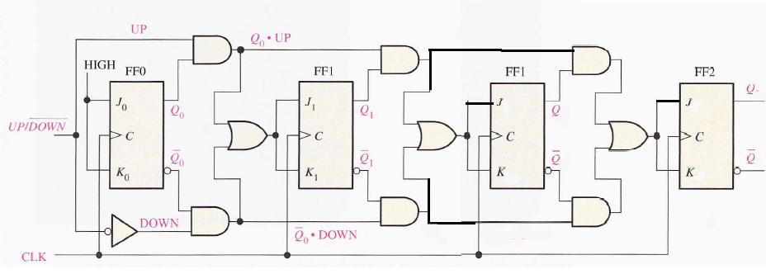
4-BIT UP/DOWN COUNTER

Slide 3
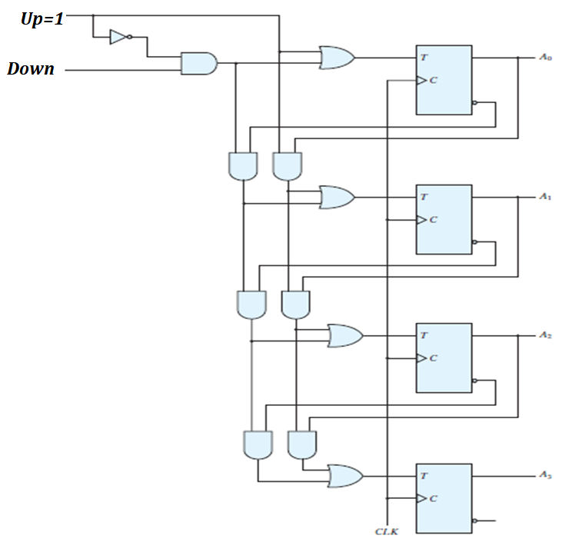
4-BIT UP/DOWN COUNTER

Slide 4
4-BIT UP/DOWN COUNTER
UP | DOWN | COMMENT
0 | 0
0 | 1
1 | 0
1 | 1

Slide 5
4-BIT UP/DOWN COUNTER

Slide 6
4-BIT UP/DOWN COUNTER
UP | DOWN | COMMENT
0 | 0
0 | 1
1 | X | UP

Slide 7
4-BIT UP/DOWN COUNTER
UP | DOWN | COMMENT
0 | 0
0 | 1
1 | X | UP

Slide 8
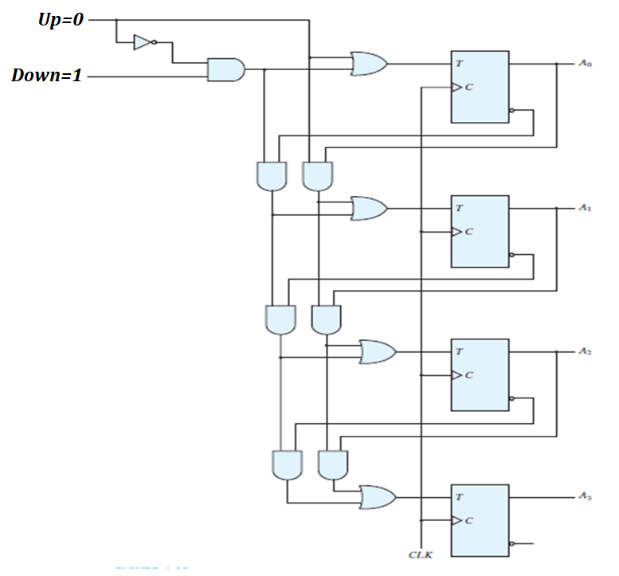
4-BIT UP/DOWN COUNTER

Slide 9
4-BIT UP/DOWN COUNTER
UP | DOWN | COMMENT
0 | 0
0 | 1 | DOWN
1 | X | UP

Slide 10
4-BIT UP/DOWN COUNTER
UP | DOWN | COMMENT
0 | 0
0 | 1 | DOWN
1 | X | UP

Slide 11
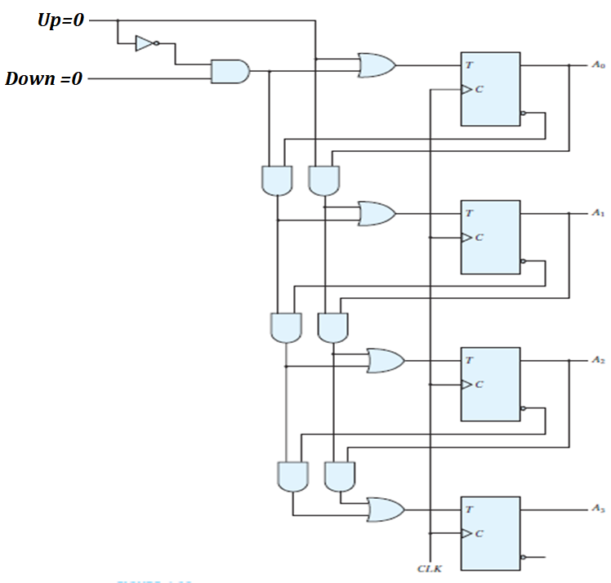
4-BIT UP/DOWN COUNTER

Slide 12
4-BIT UP/DOWN COUNTER
UP | DOWN | COMMENT
0 | 0 | NO CHANGE
0 | 1 | DOWN
1 | X | UP

Slide 13
THANKS

Slide 14
BCD COUNTER
PRESENT STATE |  |  |  | NEXT STATE |  |  |  | OUTPUT
0 | 0 | 0 | 0 | 0 | 0 | 0 | 1 | 0
0 | 0 | 0 | 1 | 0 | 0 | 1 | 0 | 0
0 | 0 | 1 | 0 | 0 | 0 | 1 | 1 | 0
0 | 0 | 1 | 1 | 0 | 1 | 0 | 0 | 0
0 | 1 | 0 | 0 | 0 | 1 | 0 | 1 | 0
0 | 1 | 0 | 1 | 0 | 1 | 1 | 0 | 0
0 | 1 | 1 | 0 | 0 | 1 | 1 | 1 | 0
0 | 1 | 1 | 1 | 1 | 0 | 0 | 0 | 0
1 | 0 | 0 | 0 | 1 | 0 | 0 | 1 | 0
1 | 0 | 0 | 1 | 0 | 0 | 0 | 0 | 1

Slide 15
BCD COUNTER
PRESENT STATE |  |  |  | NEXT STATE |  |  |  | OUTPUT | FLIP FLOP INPUTS
0 | 0 | 0 | 0 | 0 | 0 | 0 | 1 | 0
0 | 0 | 0 | 1 | 0 | 0 | 1 | 0 | 0
0 | 0 | 1 | 0 | 0 | 0 | 1 | 1 | 0
0 | 0 | 1 | 1 | 0 | 1 | 0 | 0 | 0
0 | 1 | 0 | 0 | 0 | 1 | 0 | 1 | 0
0 | 1 | 0 | 1 | 0 | 1 | 1 | 0 | 0
0 | 1 | 1 | 0 | 0 | 1 | 1 | 1 | 0
0 | 1 | 1 | 1 | 1 | 0 | 0 | 0 | 0
1 | 0 | 0 | 0 | 1 | 0 | 0 | 1 | 0
1 | 0 | 0 | 1 | 0 | 0 | 0 | 0 | 1

Slide 16
BCD COUNTER
PRESENT STATE |  |  |  | NEXT STATE |  |  |  | OUTPUT | FLIP FLOP INPUTS
0 | 0 | 0 | 0 | 0 | 0 | 0 | 1 | 0 |  |  |  | 1
0 | 0 | 0 | 1 | 0 | 0 | 1 | 0 | 0 |  |  | 1 | 1
0 | 0 | 1 | 0 | 0 | 0 | 1 | 1 | 0 |  |  |  | 1
0 | 0 | 1 | 1 | 0 | 1 | 0 | 0 | 0 |  | 1 | 1 | 1
0 | 1 | 0 | 0 | 0 | 1 | 0 | 1 | 0 |  |  |  | 1
0 | 1 | 0 | 1 | 0 | 1 | 1 | 0 | 0 |  |  | 1 | 1
0 | 1 | 1 | 0 | 0 | 1 | 1 | 1 | 0 |  |  |  | 1
0 | 1 | 1 | 1 | 1 | 0 | 0 | 0 | 0 | 1 | 1 | 1 | 1
1 | 0 | 0 | 0 | 1 | 0 | 0 | 1 | 0 |  |  |  | 1
1 | 0 | 0 | 1 | 0 | 0 | 0 | 0 | 1 | 1 |  |  | 1

Slide 17
BCD COUNTER
PRESENT STATE |  |  |  | NEXT STATE |  |  |  | OUTPUT | FLIP FLOP INPUTS
0 | 0 | 0 | 0 | 0 | 0 | 0 | 1 | 0 | 0 | 0 | 0 | 1
0 | 0 | 0 | 1 | 0 | 0 | 1 | 0 | 0 | 0 | 0 | 1 | 1
0 | 0 | 1 | 0 | 0 | 0 | 1 | 1 | 0 | 0 | 0 | 0 | 1
0 | 0 | 1 | 1 | 0 | 1 | 0 | 0 | 0 | 0 | 1 | 1 | 1
0 | 1 | 0 | 0 | 0 | 1 | 0 | 1 | 0 | 0 | 0 | 0 | 1
0 | 1 | 0 | 1 | 0 | 1 | 1 | 0 | 0 | 0 | 0 | 1 | 1
0 | 1 | 1 | 0 | 0 | 1 | 1 | 1 | 0 | 0 | 0 | 0 | 1
0 | 1 | 1 | 1 | 1 | 0 | 0 | 0 | 0 | 1 | 1 | 1 | 1
1 | 0 | 0 | 0 | 1 | 0 | 0 | 1 | 0 | 0 | 0 | 0 | 1
1 | 0 | 0 | 1 | 0 | 0 | 0 | 0 | 1 | 1 | 0 | 0 | 1

Slide 18
BCD COUNTER
PRESENT STATE |  |  |  | OUT PUT | FLIP FLOP INPUTS
0 | 0 | 0 | 0 | 0 | 0 | 0 | 0 | 1
0 | 0 | 0 | 1 | 0 | 0 | 0 | 1 | 1
0 | 0 | 1 | 0 | 0 | 0 | 0 | 0 | 1
0 | 0 | 1 | 1 | 0 | 0 | 1 | 1 | 1
0 | 1 | 0 | 0 | 0 | 0 | 0 | 0 | 1
0 | 1 | 0 | 1 | 0 | 0 | 0 | 1 | 1
0 | 1 | 1 | 0 | 0 | 0 | 0 | 0 | 1
0 | 1 | 1 | 1 | 0 | 1 | 1 | 1 | 1
1 | 0 | 0 | 0 | 0 | 0 | 0 | 0 | 1
1 | 0 | 0 | 1 | 1 | 1 | 0 | 0 | 1

Slide 19
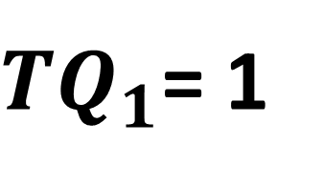
BCD COUNTER
PRESENT STATE |  |  |  | OUT PUT | FLIP FLOP INPUTS
0 | 0 | 0 | 0 | 0 | 0 | 0 | 0 | 1
0 | 0 | 0 | 1 | 0 | 0 | 0 | 1 | 1
0 | 0 | 1 | 0 | 0 | 0 | 0 | 0 | 1
0 | 0 | 1 | 1 | 0 | 0 | 1 | 1 | 1
0 | 1 | 0 | 0 | 0 | 0 | 0 | 0 | 1
0 | 1 | 0 | 1 | 0 | 0 | 0 | 1 | 1
0 | 1 | 1 | 0 | 0 | 0 | 0 | 0 | 1
0 | 1 | 1 | 1 | 0 | 1 | 1 | 1 | 1
1 | 0 | 0 | 0 | 0 | 0 | 0 | 0 | 1
1 | 0 | 0 | 1 | 1 | 1 | 0 | 0 | 1
 |  | 00 | 01 | 11 | 10
 | 00 | 1 | 1 | 1 | 1
 | 01 | 1 | 1 | 1 | 1
 | 11 | X | X | X | X
 | 10 | 1 | 1 | X | X

Slide 20
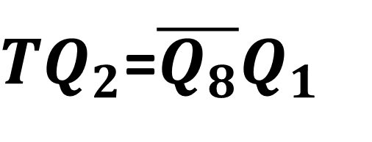
BCD COUNTER
PRESENT STATE |  |  |  | OUT PUT | FLIP FLOP INPUTS
0 | 0 | 0 | 0 | 0 | 0 | 0 | 0 | 1
0 | 0 | 0 | 1 | 0 | 0 | 0 | 1 | 1
0 | 0 | 1 | 0 | 0 | 0 | 0 | 0 | 1
0 | 0 | 1 | 1 | 0 | 0 | 1 | 1 | 1
0 | 1 | 0 | 0 | 0 | 0 | 0 | 0 | 1
0 | 1 | 0 | 1 | 0 | 0 | 0 | 1 | 1
0 | 1 | 1 | 0 | 0 | 0 | 0 | 0 | 1
0 | 1 | 1 | 1 | 0 | 1 | 1 | 1 | 1
1 | 0 | 0 | 0 | 0 | 0 | 0 | 0 | 1
1 | 0 | 0 | 1 | 1 | 1 | 0 | 0 | 1
 |  | 00 | 01 | 11 | 10
 | 00 | 0 | 1 | 1 | 0
 | 01 | 0 | 1 | 1 | 0
 | 11 | X | X | X | X
 | 10 | 0 | 0 | X | X

Slide 21
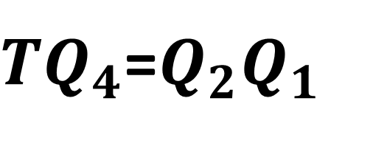
BCD COUNTER
PRESENT STATE |  |  |  | OUT PUT | FLIP FLOP INPUTS
0 | 0 | 0 | 0 | 0 | 0 | 0 | 0 | 1
0 | 0 | 0 | 1 | 0 | 0 | 0 | 1 | 1
0 | 0 | 1 | 0 | 0 | 0 | 0 | 0 | 1
0 | 0 | 1 | 1 | 0 | 0 | 1 | 1 | 1
0 | 1 | 0 | 0 | 0 | 0 | 0 | 0 | 1
0 | 1 | 0 | 1 | 0 | 0 | 0 | 1 | 1
0 | 1 | 1 | 0 | 0 | 0 | 0 | 0 | 1
0 | 1 | 1 | 1 | 0 | 1 | 1 | 1 | 1
1 | 0 | 0 | 0 | 0 | 0 | 0 | 0 | 1
1 | 0 | 0 | 1 | 1 | 1 | 0 | 0 | 1
 |  | 00 | 01 | 11 | 10
 | 00 | 0 | 0 | 1 | 0
 | 01 | 0 | 0 | 1 | 0
 | 11 | X | X | X | X
 | 10 | 0 | 0 | X | X

Slide 22
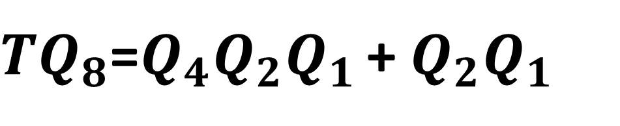
BCD COUNTER
PRESENT STATE |  |  |  | OUT PUT | FLIP FLOP INPUTS
0 | 0 | 0 | 0 | 0 | 0 | 0 | 0 | 1
0 | 0 | 0 | 1 | 0 | 0 | 0 | 1 | 1
0 | 0 | 1 | 0 | 0 | 0 | 0 | 0 | 1
0 | 0 | 1 | 1 | 0 | 0 | 1 | 1 | 1
0 | 1 | 0 | 0 | 0 | 0 | 0 | 0 | 1
0 | 1 | 0 | 1 | 0 | 0 | 0 | 1 | 1
0 | 1 | 1 | 0 | 0 | 0 | 0 | 0 | 1
0 | 1 | 1 | 1 | 0 | 1 | 1 | 1 | 1
1 | 0 | 0 | 0 | 0 | 0 | 0 | 0 | 1
1 | 0 | 0 | 1 | 1 | 1 | 0 | 0 | 1
 |  | 00 | 01 | 11 | 10
 | 00 | 0 | 0 | 0 | 0
 | 01 | 0 | 0 | 1 | 0
 | 11 | X | X | X | X
 | 10 | 0 | 1 | X | X

Slide 23
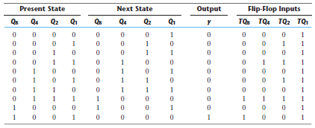
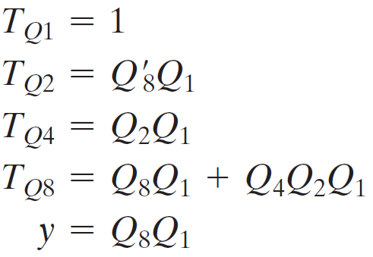
BCD COUNTER

Slide 24
THANKS

